Slide 1
Music Department
Prospective Year 7

Slide 2
The Music Department
*Keyboards
*6 string Guitars
*Drum kits
*Singing
*Bass Guitars
*Percussion Instruments
*Cubase sequences
*Muse score Notation app

Slide 3
What will you do in music lessons?
Perform music - Sing as apart of a group, play a range of different instruments
Create Music - Compose and improvise, rhythms and melodies
Notation - Use music notation to create and perform music
Listening and Appraising - Listen to music from different times and different places. (Use musical terms to describe, evaluate and compare)
Explore musical relationships (between music and outside music)

Slide 4
Perform music (sing as apart of a group, play a range of different instruments)
Musical performance is the main way of developing musicians and musicianship. Through the performance of music, students develop confidence, self-discipline, and the ability to work with others. They see themselves as a relevant part of their world and integrate prior knowledge and personal experiences into a variety of endeavors. The music they perform or study often becomes an integral part of their personal musical repertoire.

Slide 5
Create Music (Compose and improvise, rhythms and melodies)
Composing and improvising provide students with the opportunity to symbolically represent ‘ideas’ in music. To gain a unique insight into the form and structure of music and, at the same time, help them to develop their creativity. Working within the form and structure of music, students gain the ability to problem-solve and apply their basic knowledge using higher level thinking skills. These skills are enhanced through technology.

Slide 6
Notation – Use music notation
Learning to read and notate music gives students skills with which to explore music independently and with others. Reading music promotes higher level thinking skills through translation of symbols and serves as a means of communication throughout the world. A firm grounding in this standard lays the foundation for lifelong learning.

Slide 7
Listen to music from different times and different places.
Use musical terms to describe, evaluate and compare. Listening to, analyzing, and evaluating music are important building blocks of musical learning. These skills expand musical appreciation, expression, and the justification of musical preferences, leading to knowledgeable consumers and supporters of music. They also provide a foundation for critical thinking.

Slide 8
Explore musical relationships.
Understand relationships between music, the other arts, and disciplines outside the arts. Students will understand music in relation to history and culture.

Slide 9
Learn to read music so you can:
*Play chords and melodies on the keyboard
*Sing
*Play chords and melodies on the guitar
*Play drum kit 8 beat patterns

Slide 10
Learn to create your own music:
*Using Apps, Cubase, MuseScore and BeepBox
*Using the drum kit, guitar and keyboard and any other instrument you can play.

Slide 11
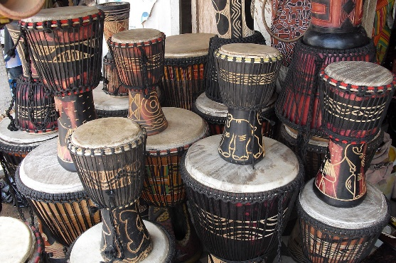
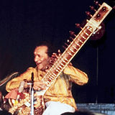
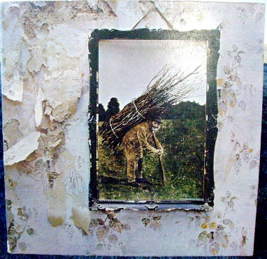
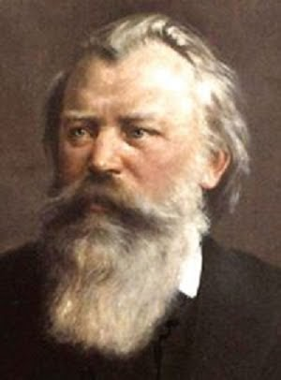
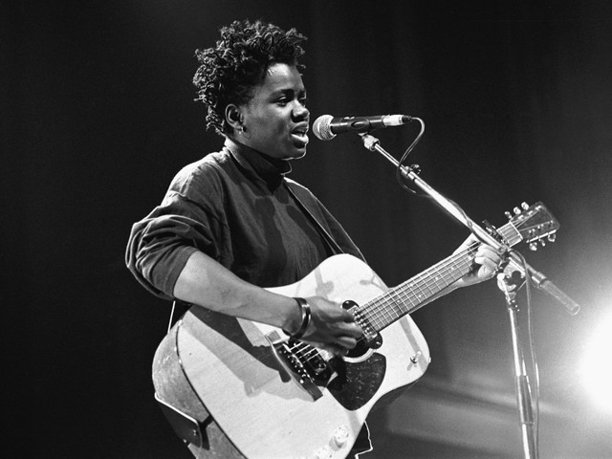
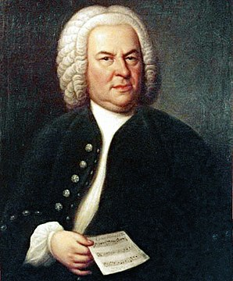
Listen to and analyse music
*From different parts of the world
From different times
From different styles and genres

Slide 12
Examples of Student work

Slide 13
Hall Mead Music Department

Slide 14
Book Up Instrumental/Vocal Music Lessons
Click link to find out about instrumental and vocal music lessons
How playing an instrument benefits your brain
Further information and book lesson.

Slide 15
Links

